Slide 1
Ethical Hacking
Vulnerability Assessment
And
Penetration Testing
Centre for Development of Advanced Computing (C-DAC)
Electronics City, Bangalore.

Slide 2
Session Coverage
What is Security all about ?
What are we trying to secure ?
Various Hackers Class
Steps involved in a hack
Various Cause Of Attacks
Discuss Various Attacks in brief
Demo

Slide 3
Why Security?
Threat to your assets
Assets
  Hardware
      Can be stolen, broken or disabled
  Software
      Can be deleted, copied or modified to do unintended tasks
  Data
      Can be deleted, read, or modified
  Communication lines
      Can be destroyed, messages can be read, delayed, modified and fabricated

Slide 4
Computer Security
Protection of data in a system against
  Unauthorized disclosure
  Modification
  Destruction
Protection of the computer system against
  Unauthorized use
  Modification
  Denial of service

Slide 5
Security Is a Myth
If a hacker wants to get inside your system, he will and there is nothing you can do about it.
The only this you can do is to make it harder for the attacker to get in.

Slide 6
Hackers Class
Black Hat
  “A person with extraordinary computing skills involved in malicious or destructive activities“
White Hat
  “Person possessing hackers skill using them for defensive purpose aka security analyst”
Gray Hat
  “Person who plays a role of black hat and white hat at various times”
Suicide Hackers
  “A person committed to bring down critical infrastructure without worrying to face punishments”

Slide 7
Triangle Phenomenon
Moving the ball toward security means moving away from functionality and ease of use.
Functionality
Security
Ease Of Use

Slide 8
Basic Steps Of Hacking
Reconnaissance
Scanning
Gaining Access
Retaining Access
Covering Tracks

Slide 9
Reconnaissance
Reconnaissance is the phase for the attacker to collect and gather as much information as possible about the target of evaluation prior to launching an attack
Types of Reconnaissance
  Passive reconnaissance involves acquiring information without directly interacting with the target
    eg. search public records, news
  Active reconnaissance involves interacting with the target directly by any means
    Telephone, email etc.

Slide 10
Tools for Reconnaissance
DNS
  Nslookup
  Whois
  ARIN
Trace route
  Traceroute
  Visualroutetrace
Email
  Visual route mail tracker
  EmailTrackpro

Slide 11
Scanning
Scanning refers to the pre-attack phase when the hacker scans the network for specific information on the basis of information gathered during reconnaissance
Scanning includes
  Port scanners
  Network mapping
  Vulnerability scanners
  etc.

Slide 12
Types of Scanning
Network Sweeps
Network tracing
Port scans
OS fingerprinting
Version scans
Vulnerability scans

Slide 13
Tools for Scanning
Nmap
Hping2
Firework
Nessus
Nikto
Nemessis

Slide 14
Gaining Access
Gaining Access refers to the penetration phase. The hacker exploits the vulnerability in the target of evaluation
Gaining of access can be achieved by
  Buffer overflows
  Denial of services
  Session hijacking
  Password cracking

Slide 15
Tools For Gaining Access
Tools for Gaining Access
Password Cracking
  Dictionary Attack, Brute-force attack : John the Ripper, sniffers
Escalating privilege
  Cracking NT/2000 Password
Executing Applications
  Host/remote key loggers
Buffer Overflows
  Metasploit

Slide 16
Tools for Gaining Access
DOS attacks
  Trinvo
  TFN2K
Social Engineering
  Phishing URLs
  Email, Telephone

Slide 17
Exploit Categories
  Server Side
  Client Side
  Local Privilege Escalation

Slide 18
Retaining Access
Retaining Access refers to the phase when the hacker tries to retain the ownership of the system
The hacker has compromised the system
Hackers may harden the system from other hackers as well
Hackers can upload, download or manipulate data, applications or configurations on the owned system

Slide 19
Retaining Access
Trojans
  Netcat
  Loki
Rootkits
  Knark, Torn etc

Slide 20
Covering Tracks
Covering Track refers to the activities that the hacker undertakes to hide his misdeed
Reasons include the need for prolonged stay, continued use of resources, removing evidence of hacking or avoiding legal action

Slide 21
Tools for covering Tracks
Steganography
  Camoflouge
  MP3Stego
Tunnelling
  HTTPTunnel

Slide 22
Type Of Attacks
Operating System Attacks
Application Level Attacks
Shrink Wrap Code Attacks
Misconfiguration Attacks

Slide 23
Operating System Attacks
Today’s Operating System are complex in nature
Operating system run many services, ports, and modes of access and require access tweaking to lock them down.
Default installation leaves the OS with large number of open ports and unwanted services running
Apply patches, because attackers look for OS vuln. And exploit them to gain access

Slide 24
Application Level Attack
Software Developers are under tight schedule to deliver products on time.
Software applications have tons of functionalities and features
Sufficient time is not there to perform complete testing before releasing products.
Security is often an after thought and usually delivered as add-on component.
Poor or non-existing error checking in applications which leads to Buffer Overflow

Slide 25
Shrink Wrap Code Attack
When you install an Operating System, it comes with tons of sample script to make the life of an administrator easy.
The problem is not fine tuning or customizing these scripts.
This will lead to default code or shrink wrap code attack

Slide 26
Misconfiguration Attack
System that should be fairly secure are hacked because they were not configured correctly
System are complex and the administrator does not have the necessary skills or resources to fix the problem.
Administrator will create the simple configuration that works
Remove unneeded services or software.

Slide 27
Vulnerability Research
To identify and correct network vulnerabilities.
To protect the network from being attacked by intruders.
To get information that help to prevent security problems.
To know how to recover from network attacks.

Slide 28
Vulnerability Research Web Sites
www.securitytracker.com
www.microsoft.com/security
www.securiteam.com
www.packetstormsecurity.com
www.hackerstrom.com
www.hackerwatch.org
www.securityfocus.com
www.securitymagazine.com

Slide 29
Pen test
Determine how susceptible your network is to external or internal attacks and access the effectiveness of your safegaurds
Attempt to exploit the weaknesses and demonstrate the effectiveness of the security measures

Slide 30
Ground Reality
CVE vulnerabilities on average 7 per day
Bugtraq mailing list publishes almost 100 vulnerabilities every week .
Security not a primary consideration while designing software .
Implementations are buggy .
Networks are more open and accessible than ever .

Slide 31
Ground Reality
Mistaken assumptions and unawareness about security
Internet Revolution & Crackers at large
Intense cut-throat competition between companies
The future is fully connected. New technologies rely on networks and computers

Slide 32
All About Attacks
Sql Injection
Url Scrawler Attacks
Using Who is Performing Attacks
Traceroute to trace routers
ARP Poisioning
Man in the Middle (MITM)
MAC Flooding
Cookie Stealing Attacks
Hack Gmail and Yahoo mail accounts in LAN
Protocol Stripping Attacks

Slide 33
All About Attacks
Cross Site Scripting (XSS)
Session Fixation
Cross Site Request Forgery (CSRF)
TCP Session Hijacking Attack
Google Hacks
Social Engineering Attack

Slide 34
What Is SQL Injection ?
Sql Injection is a type of security exploit in which the attacker injects SQL query through a web from input box , to gain access to resources, or make changes to data.
It is a technique of injecting SQL commands to exploit non-validated input vulnerabilities in a web application database backend.
Programmers use sequential commands with user input , making it easier for attackers to inject commands.
“select * from table where user=‘$v1’ and pass=‘$v2’ ”

Slide 35
Exploiting Web Applications
It exploits web applications using client-supplied SQL queries.
It enables the attackers to execute unauthorized SQL commands.
It also takes advantage of unsafe query in web applications and build dynamic SQL query
For Example when users logs onto a web page by using a user name and password for validation, SQL query is used.

Slide 36
What you should look for
Try to look for pages that allow user to submit data, a log in page, a search page .
Look for HTML pages that use POST or GET Commands
Check the source code of the HTML to get information.

Slide 37
Other Techniques
If input page is not present then check for pages like ASP, JSP, CGI, or PHP
Check for URL’s that take parameters.
http://www.xyz.com/index.php?id=0
http://www.xyz.com/index.asp?id=blah’ or 1=1--

Slide 38
URL Crawlers
Defination
  A URL Crawler is a computer program that browses the given URL in a methodical automated manner.
Utilities
  Gather pages and URL from the given web site
  Support search engine and used for data mining and so on.

Slide 39
Whois
Whois is a query/response protocol that is widely used for querying database in order to determine the registrant or assignee of internet resources, such as a domain name, an IP address block or an autonomus system number.
Reference:- Wikipedia

Slide 40
Whois References
ARIN: http://ws.arin.net/whois
RIPE NCC: http://www.ripe.net/whois/
APNIC: http://whois.apnic.net
LACNIC: http://whois.lacnic.net
AfriNIC: http://whois.afrinic.net
www.whois.org

Slide 41
Traceroute
Traceroute is a network tool which shows the path taken by the packet to reach its destination. It works by using the TTL field of the IP Protocol
Used for network troubleshooting .
Used for information gathering of the network architecture.

Slide 42
ARP Poisoning
ARP Poisoning is a kind of spoofing in which a forged ARP reply is sent to the original ARP request
Updation of target computer cache with a forged entry.
The Victim Machine starts sending the packet to the attacker thus allowing attacker to sniff the packets.

Slide 43
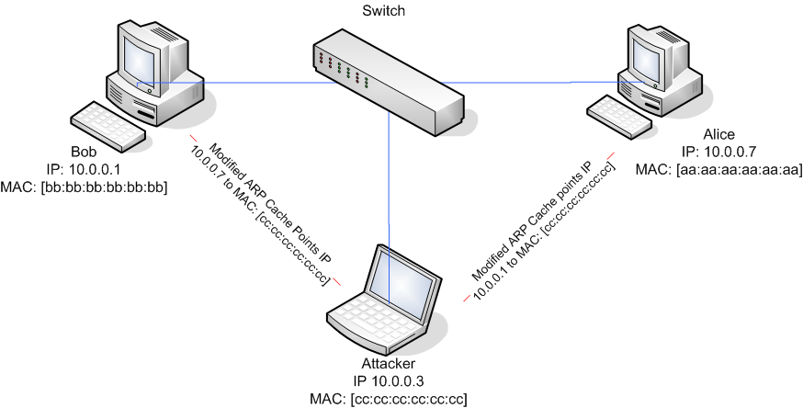
ARP Poisoning

Slide 44
Vulnerable and Non Vulnerable OS
OS Vulnerable to ARP Spoofing
  Windows 98/2000
  Windows NT
  Linux
  Netgear
  AIX 4.3
OS NOT Vulnerable to ARP Spoofing
  Sun Solaris

Slide 45
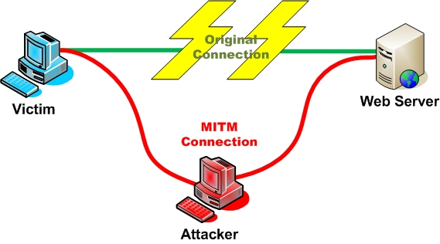
Man In The Middle (MITM)
Man in the middle is a type of a attack in which the attacker forms independent connection with the client and the server and is transparent to each of them.

Slide 46
Man In The Middle (MITM)
Possible Causes Of Man In The Middle Attack
  ARP Poisioning
  DNS poisioning
  Route Mangling
  Proxy

Slide 47
Once In The Middle
It is the easiest attack to launch since all the packets transit through the attacker
All the “plain text” protocols are compromised (the attacker can sniff user and password of many widely used protocols such as telnet, ftp, http)
It is transparent to the victims on either side.
It can issue its own certificate to form secure connection (HTPS).

Slide 48
Consequences
Attacker can add packets to already established connection
The attacker can modify the sequence number and keep the connection synchronized while injecting packets
If the mitm attack is “proxy attack” it is even easier to inject.
The attacker can modify the payload by recalculating the checksum.
Can create filters on the fly

Slide 49
MAC Flooding Attack
This attack targets switches .
Flood the switch with fake MAC addresses.
CAM is full with fake MAC address
Thus switch bleeds the traffic out
Switch starts behaving like a HUB

Slide 50
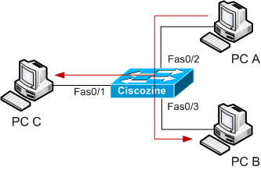
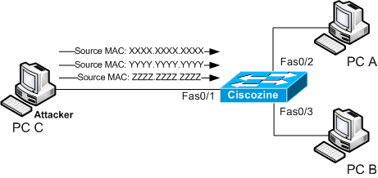
MAC Flooding Attack
Attacker Does The MAC Flooding
Switch Bleeds The Traffic Out

Slide 51
What Is A Cookie ?
Short piece of text generated during web activity and stored in the user’s machine for future references.
Instructions for reading and writing cookies are coded by website authors and executed by user browsers.
Developed for user convenience to allow customization of sites without need for repeating preferences
Used as an identity of the user using the web server.

Slide 52
Cookie Facts
Most cookie stored just 1 data value
A cookie may not exceed 4Kb in size
Browsers are preprogrammed to allow a total of 300 cookies, after which automatic deletion based on expiry date and usage.
Cookies have 3 key attributes: name, value expiry date.

Slide 53
Cookie Algorithm
Start :
On Page Load
Read Cookie
Is Cookie Empty
NO
YES
Use Cookie Info to customize /login etc
Write new cookie prompt for info if necessary
Continue Loading Page
Update cookie

Slide 54
Cookie Stealing
Cookie can be steeled through sniffing of the traffic
By using some scripts that will execute on client browser thus revealing the cookie information to the attacker.
By using Man in the Middle technique.

Slide 55
Using Cookie Editor For Hacking
Cookie Editor available as an Add-On of mozilla
Helps in viewing cookies
Cookie Editor helps in updating, deleting and modifying the present cookies.

Slide 56
Protocol Stripping Attack
Why hackers strip a protocol ?
  Can we decrypt SSL encryption ?
    Till date no mechanism has been devised
  Does this means HTTPS protocol is secure
    Hackers dont think so.
  Can HTTPS be tricked
    Definitely “YES”

Slide 57
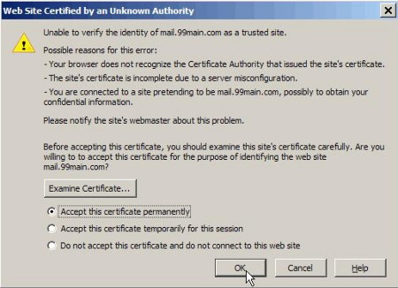
Positive Browsers

Slide 58
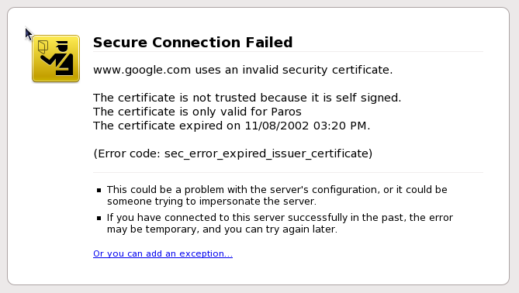
Negative Browsers

Slide 59
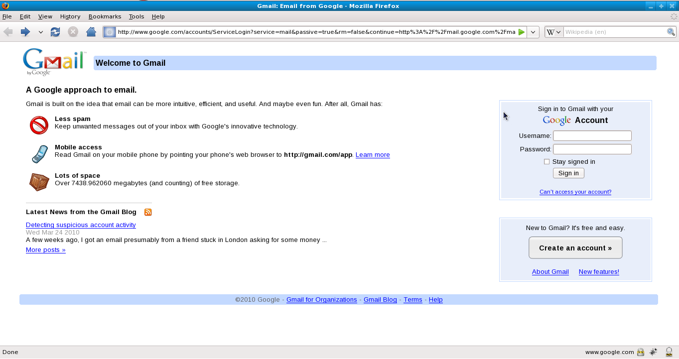
Gmail Login Page ?

Slide 60

Gmail Login Page ?

Slide 61
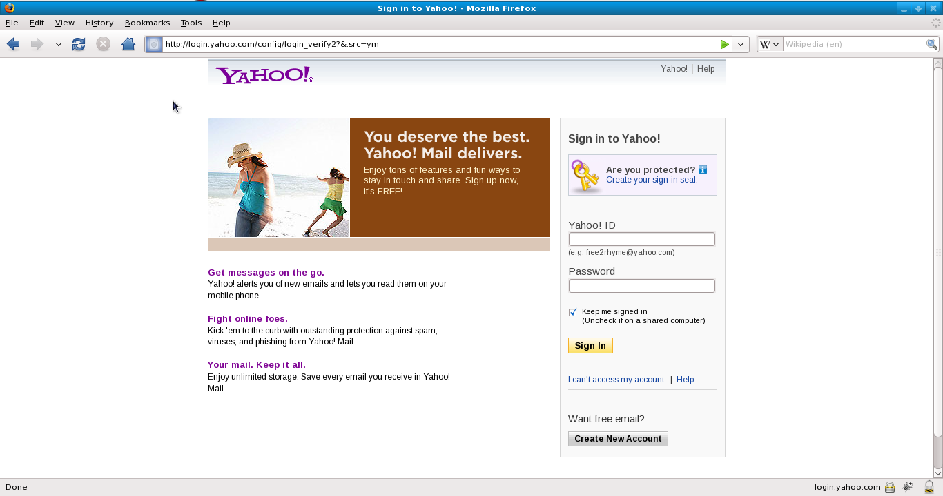
Yahoo Login Page ?

Slide 62
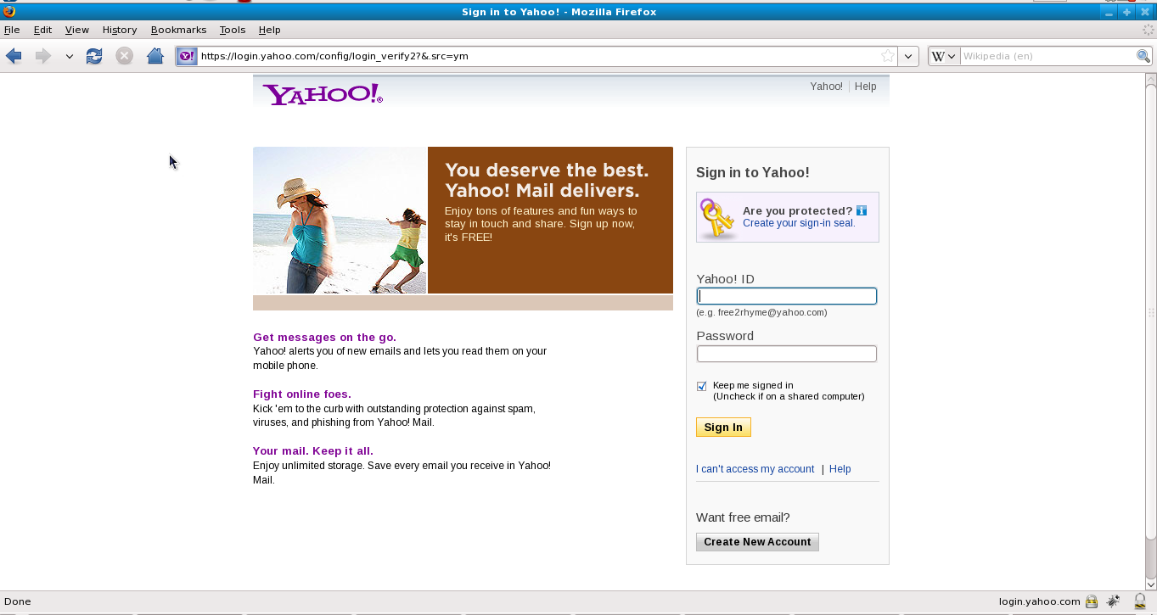
Yahoo Login Page ?

Slide 63
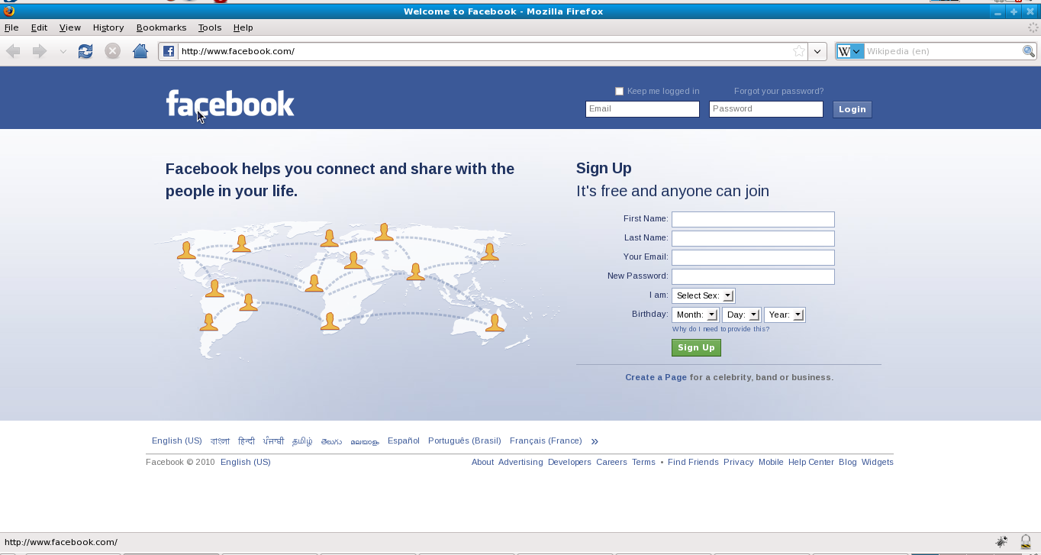
Facebook Login Page ?

Slide 64
Facebook Login Page ?

Slide 65
What’s Going On Behind ?
HTTP
HTTPS
Host A
Attacker
Host B

Slide 66
Cross Site Scripting Attack (XSS)
Cross site scripting occurs when an attacker uses a web application to send malicious code, like java script
Stored XSS
  Stored attacks are those where the injected code is permanently stored in the target server data base
Reflected XSS
  Reflected attacks are those where the injected code takes another route to the victim

Slide 67
Consequences of XSS
Disclosure of the user’s session cookie allows an attacker to hijack the user’s session and take over the account.
In XSS end user files are disclosed, trojan horse are installed, the user is redirected to some other page and the presentation of the content is modified.
Web servers, application servers, and web application environments are susceptible to cross site scripting.

Slide 68
Session Fixation Attack
In session fixation attack the user fixes the session key, even before the user logs into the server thus eliminating the need to steal the session key and helps the attacker to take over the victims account.
Steps For Session Fixation Attack :
Session Setup
Session Fixation
Session Entrance

Slide 69
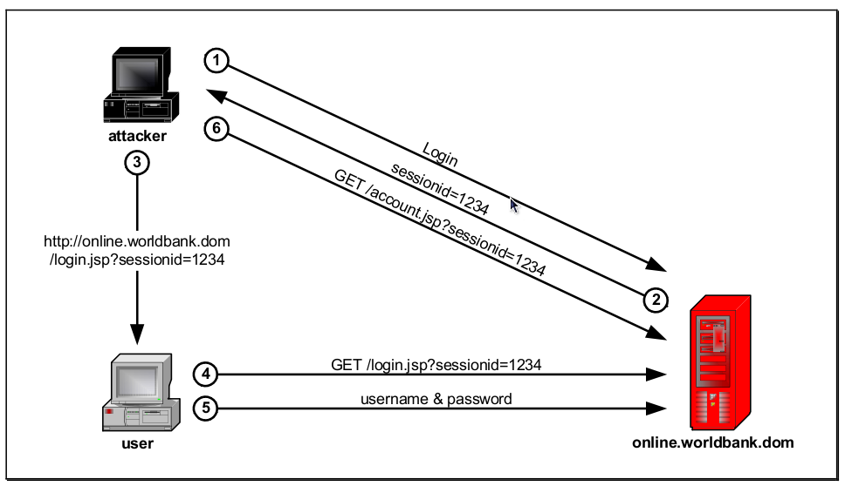
Session Fixation Attack

Slide 70
TCP Session Hijacking
TCP Session hijacking is a hacking tech. That uses spoofed packets to take over the connection b/w a victim and a target machine.
The victim connection hangs, and the hacker is then able to communicate with the host’s machine as if the attacker is the victim.
To launch the TCP session hijacking the attacker must be on the same network as the victim.

Slide 71
TCP Session Hijacking
SYN ISN 4000
SYN ISN 5000 / ACK 4001
ACK 5001
SEQ 4000 DATA 128
ACK 4129
SEQ 4129 DATA 91
ACK 4220
SEQ 4220 DATA 10
ACK 4230
SEQ 4230 DATA 512
SEQ 4220 DATA 145

Slide 72
CROSS SITE REQUEST FORGERY
This attack forces another user’s browser to do something on attacker’s behalf
CSRF attacks are effective in number of situations
The victim has an active session on the target site
The Victim is authenticated via HTTP auth on target site
If the user is an logged in as an administrator on a website, the attack can be used to escalate privilege.

Slide 73
TYPES OF CSRF
Classical CSRF
In the course of web browsing the target user encounters a request from a malicious site or location that makes a request on behalf of the user to a site the user is already authenticated to. CSRF seeks to use victims cookie to force victim to execute a trade without his knowledge or consent.
Dynamic CSRF
In a “dynamic” CSRF scenario attacker creates a customized, per-request forgery, based on each user’s session specific information, including valid CSRF tokens and other parameters specific to theuser’s session.

Slide 74
Google Hacks
inurl: adminlogin.php
“login: *” “password= *” filetype:xls
intitle:"Live View / – AXIS"
intitle:"index.of.personal"
intitle:index.ofadministrators.pwd
intitle:"index of" intext:connect.inc
filetype:ini
lot of google hacking keywords can be referred from google hacking database (GHDB).

Slide 75
Social Engineering
Victim is tricked to reveal confidential information
A non technical attack
Still more dangerous and powerful from most of the complex technical attacks.
Does not require technical skills

Slide 76
?

Slide 77
Thank You

